Slide 1

Toxic Comments classification using BERT
By Arpita Gupta

Slide 2

Arpita Gupta
Data Scientist, Accenture
Post Graduate (M.E.), BITS Pilani
https://www.letthedataconfess.com/
https://www.linkedin.com/in/arpita-gupta5a5496137/
https://twitter.com/arpita__gupta
https://www.quora.com/profile/Arpita-Gupta-15
https://www.kaggle.com/arpitagupta2915

Slide 3
Agenda
Understand the problem
How Natural Language Processing will help
Let’s understand the Data
Solution using deep learning models:
CNN
LSTM
Transformers
All about BERT
Let’s get our hands dirty with the code

Slide 4
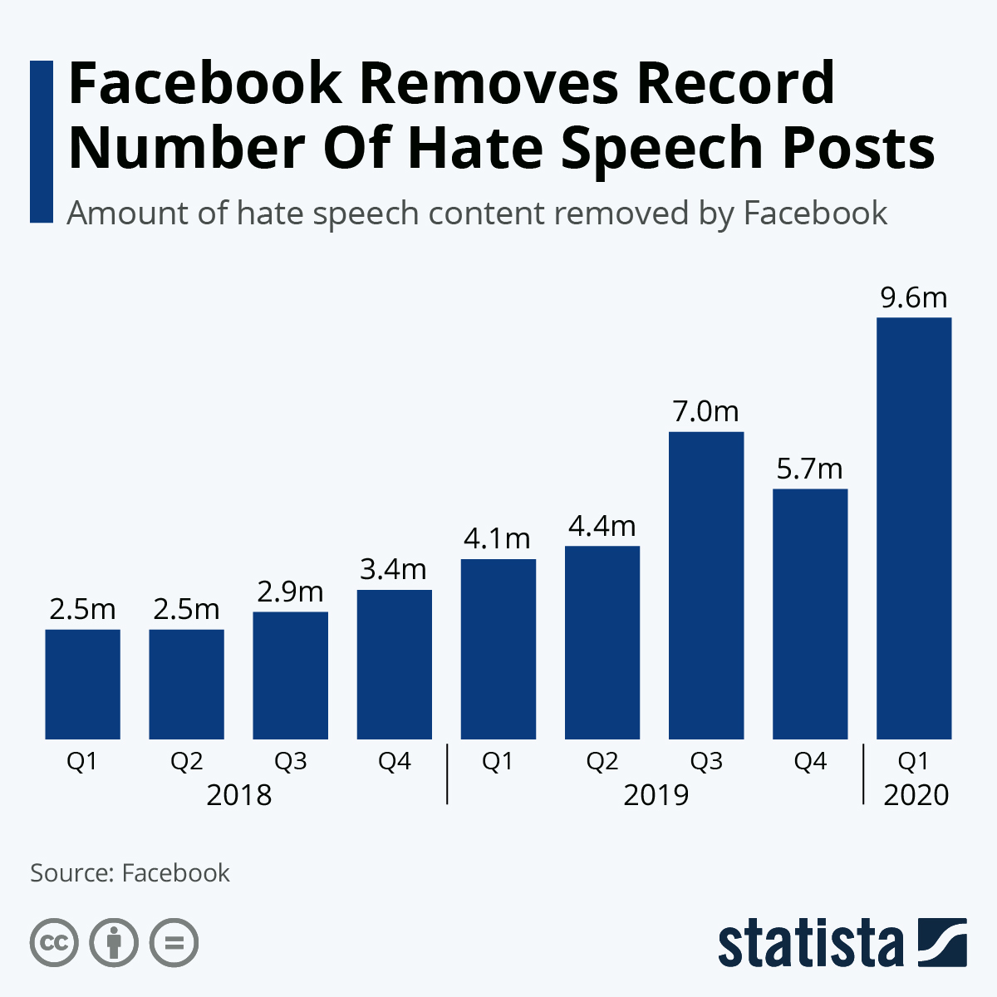
Current Statistics
Ref: https://elexonic.com/2020/05/18/facebook-removes-record-number-of-hate-speech-posts/

Slide 5
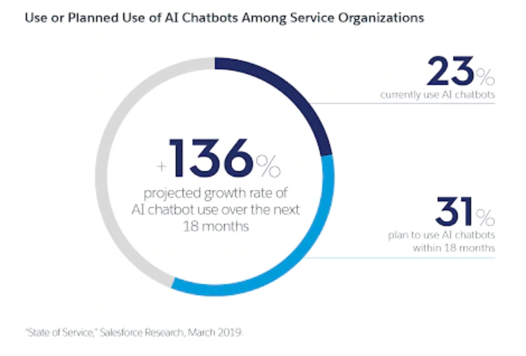
Why is it rising
Rising trend of mobile and apps usage.
More activeness on social media

Slide 6
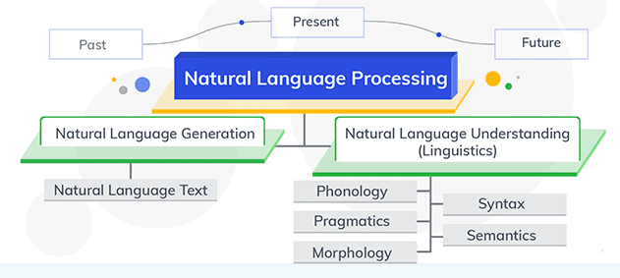
Natural language processing
Source: https://www.xenonstack.com/blog/evolutiaon-of-nlp/

Slide 7
Key technologies underpinning Natural Language Processing
Machine Learning: Learn over the data, train algorithms and make it in action. E.g. Booked Appointment
Deep Learning: It enable machines to learn more accurately and provide efficient results. E.g. Correct misspelled search query, deliver real time speech translations
Natural Language Processing: NLP helps AI algorithm to better understand context and meaning of user’s query. E.g. Build recommendation engine, processing search query correctly, render synonyms, Jargon and abbreviations correctly.

Slide 8
Let’s understand the data
You are provided with a large number of Wikipedia comments which have been labeled by human raters for toxic behavior. The types of toxicity are:
toxic
severe_toxic
obscene
threat
insult
identity_hate
You must create a model which predicts a probability of each type of toxicity for each comment.

Slide 9
Key Challenges
Presence of Sarcasm
Long term dependencies
Real time solution

Slide 10
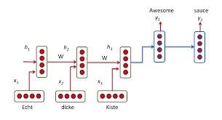
Problem with RNN
Sequential Network
Slow
Not truly bi-directional

Slide 11
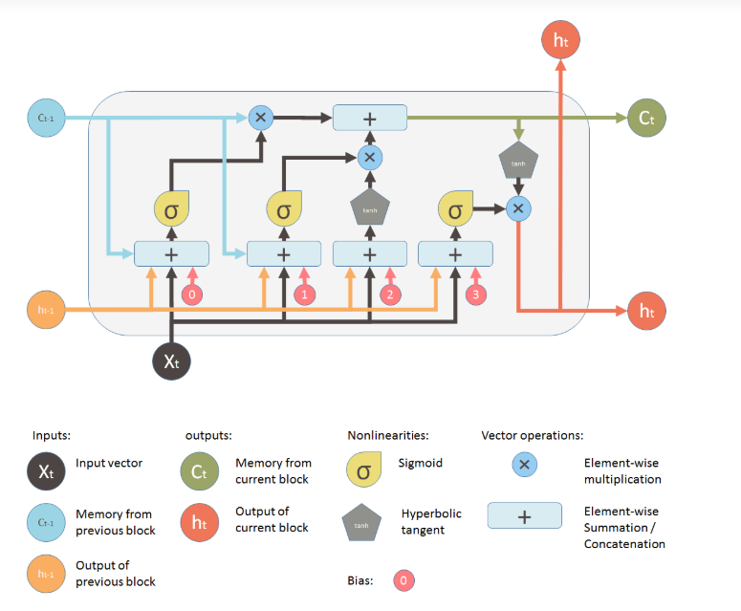
LSTM

Slide 12

Solution
BERT (Bi-directional encoder representation from transformer )

Slide 13
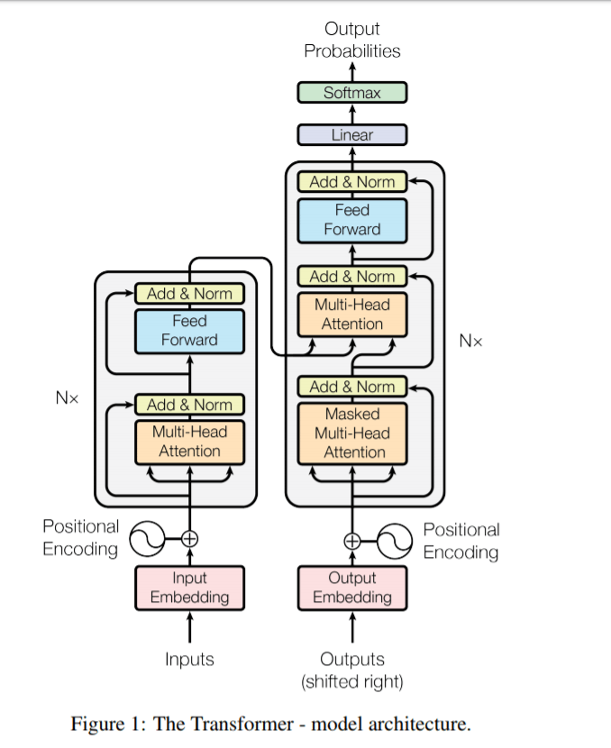
Transformer
Faster
Deeply bi-directional (context can be learnt efficiently)

Slide 14


Show me more.. I want to dive deeper!!

Slide 15

How to user BERT to solve this challenge
Pre-train BERT to understand the language first
Fine tune the BERT to learn specific task

Slide 16
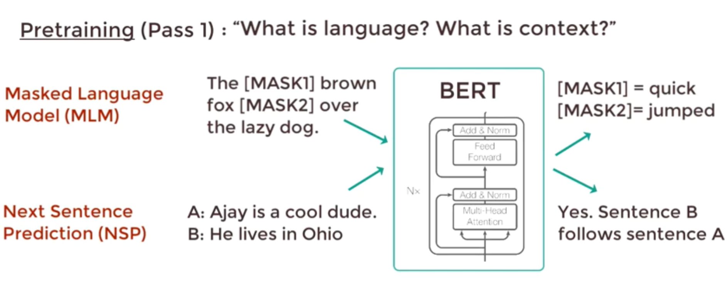
Bi-directional Encoder Representation of Transformers

Slide 17
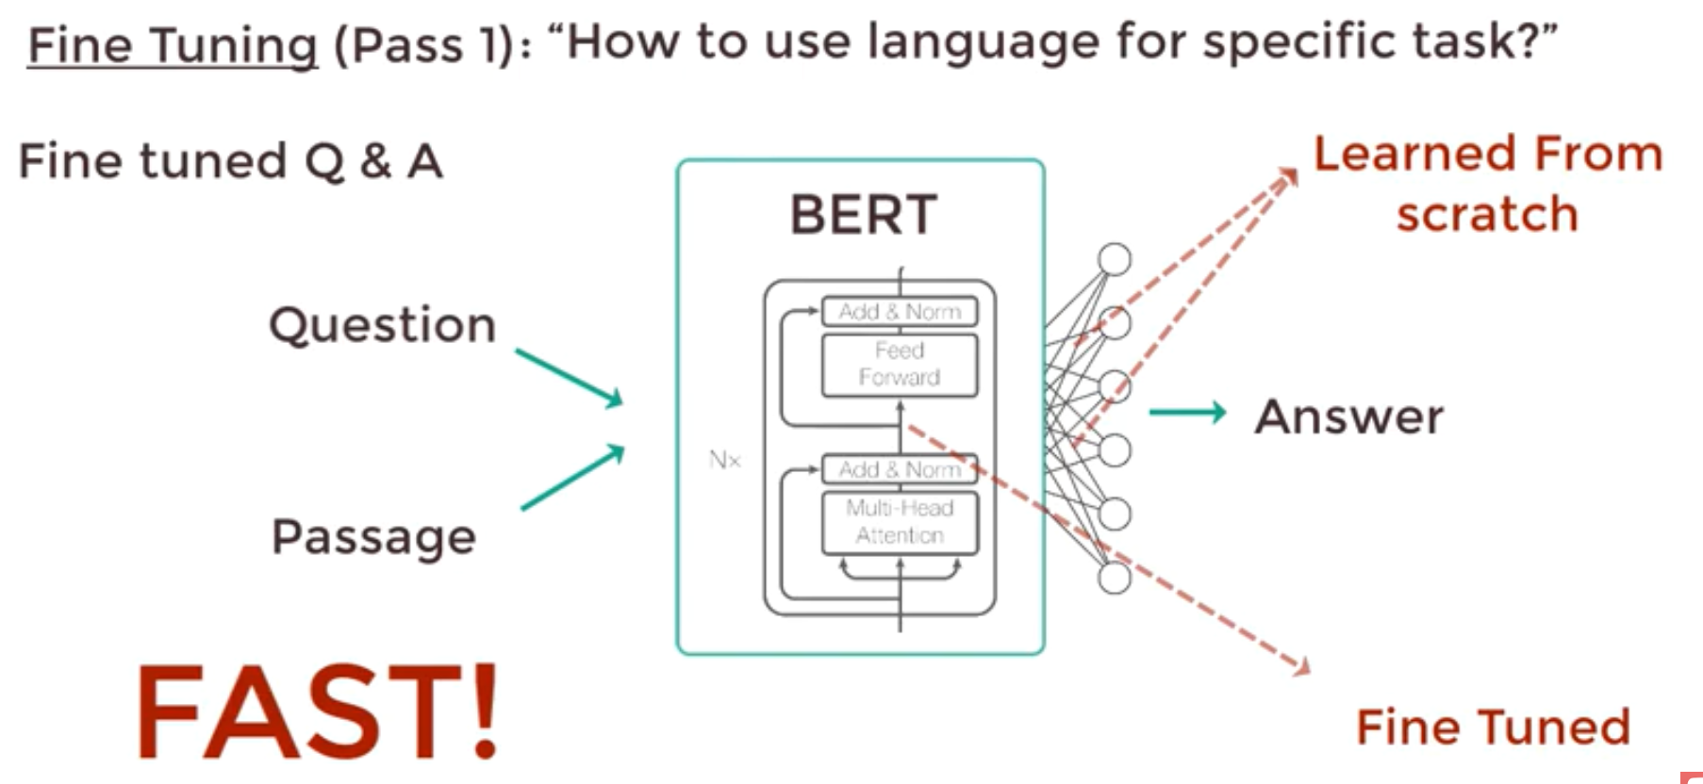
Bi-directional Encoder Representation of Transformers

Slide 18
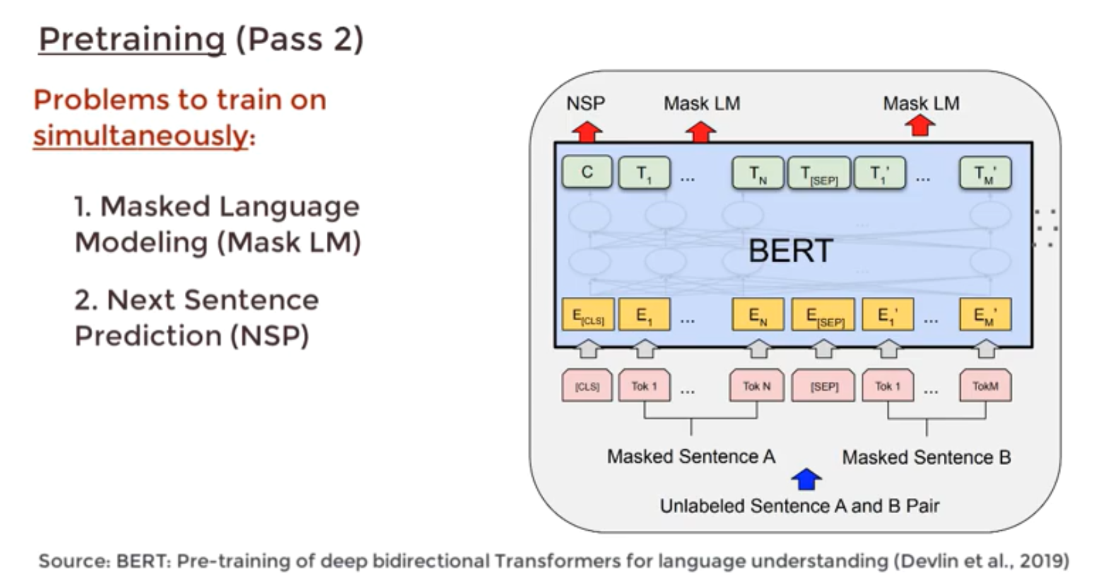
Bi-directional Encoder Representation of Transformers

Slide 19
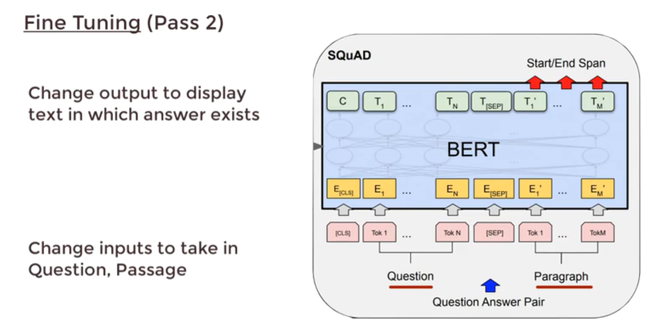
Bi-directional Encoder Representation of Transformers

Slide 20
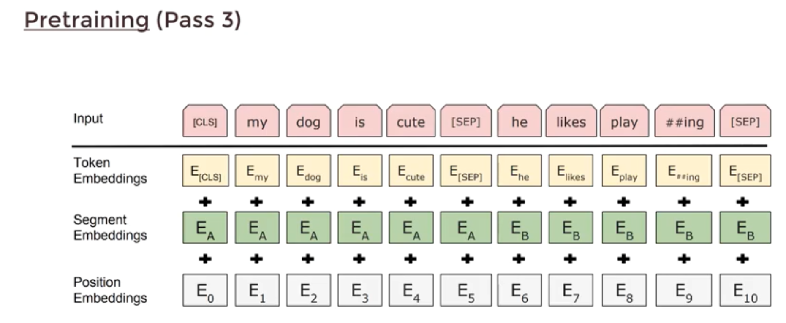
Bi-directional Encoder Representation of Transformers

Slide 21
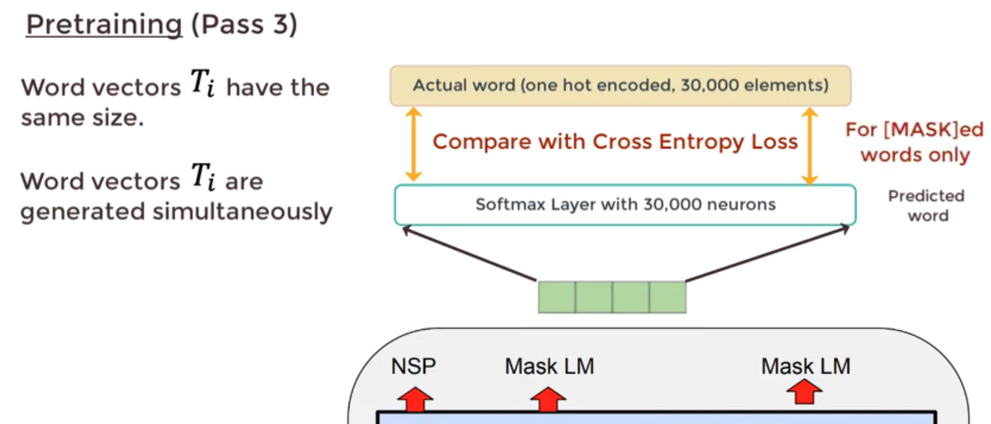
Bi-directional Encoder Representation of Transformers

Slide 22
Let’s get our hands dirty with the code

Slide 23

Q&A

